Slide 1
Learn and Help 3.0 End User Manual
Team Alligators
Mekdes Gebrechristos, Hamdi Kelil, Jet Lao, Pong Lee, Daniel Kolles

Slide 2
Overview
Welcome / Introduction
Team Alligators
Mekdes Gebrechristos
Hamdi Kelil
Pong Shoua Lee
Jet Lao
Daniel Kolles
Learn and Help 3.0 https://learnandhelp.jasthi.com/
Presentation Scope
As Administrator
New Functionality Added
Other Changes Made
As User
New Views / Capabilities
Demo (Admin / User)
Q & A
Notes:
Welcome Class and distinguished guests. Thank you for joining us. This was a really fun project for the team. We were very engaged in the work. Many opportunities to hone skills and learn about new concepts. We had a lot of fun with this – we welcome your feedback.
Introduce Members
We’ll show you functions as admin
Then show you functions available as a User/Visitor
We’ll pass the mic to team members as we parse through the functions
Finally — Q&A sessions
This is Learn & Help 3.0 (building on what existed prior)
Presentation will cover (New functions as Admin, then new capabilities for Users (User experience)
Demo the changes/additions in same manner (Admin / User)
Wrap-up with Q & A

Slide 3
Demo
Notes:
Demo will be Admin Functions first, then as User/visitor

Slide 4
Administrator Functionality

Slide 5
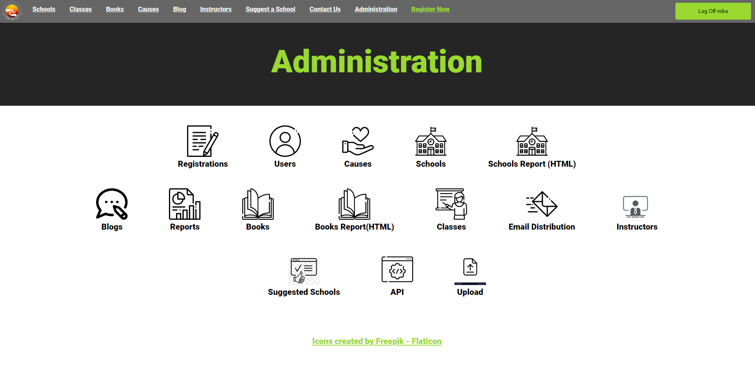
Administration Page
Notes:
Things Added or Changed
(Users) - Added Team Member names, emails, phone numbers, etc..
(Schools) - Added CRUD operations, Added Profile Picture, Moved Options selector to be visible, Image upload functionality.
(School Report HTML) - Added missing (logos)
(Books) - Added Filter (Grid vs List view), modified filter/sort by Grade Level
(Books Report HTML - Added Unicode for accessibility
(Classes) - Added CRUD operations, Modified Fields, Added “Status” dropdown, Added Delete Warning,
(Email Distribution) - Added Icon, (Functionality) - Admin sends message to users. All admin’s get the same email
(Instructors) Added Icon, (Functionality) - Able to perform CRUD operations on Instructors)
(Suggested Schools) - Fixed missing Title Bar (pending fix by Hamdi)
(API) - Added Icon, (Functionality) - Added links for Json output examples and some images.
(Upload) - Added Icon – Functionality existed. (Allows *.csv data upload to populate database)
(See slides below for detail)
(on Saturday 4/27/24 — Mekdes & Daniel will update the following slides to elaborate more in these line items above)

Slide 6
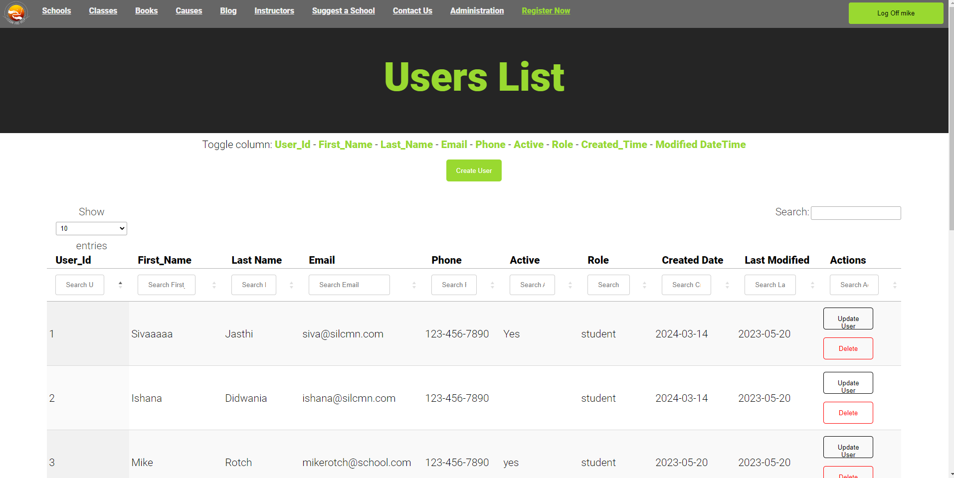
Users
As an admin
Admin can view all users
Admin can view instructors, students, and admins
Admins can create a new user
Added Team Member names, emails, phone numbers, etc..
Admins can delete users
On the top there’s a toggle for columns to better organize what the admin is looking for
Delete protection (prompt/warning)
Notes:
(Daniel)
Speak to ability to see all user types (admin, student, instructor)
Delete protection

Slide 7
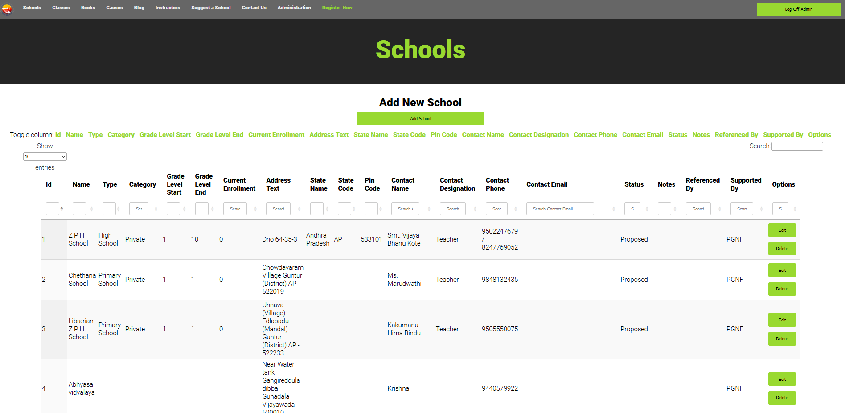
Schools
As an Admin
Admins can see all the schools that are registered
Admins can edit school details
Admins can delete school details
What we implemented/changes
Added CRUD operations, Added Profile Picture, Moved Options selector to be visible, Image upload functionality.
Notes:
(Daniel)

Slide 8
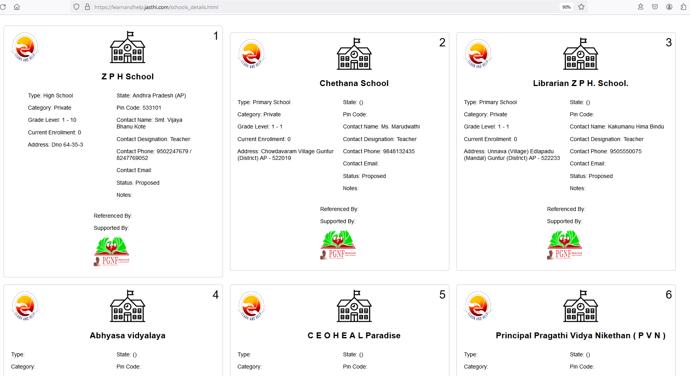
Schools Report (HTML)
As an Admin
Admin can open file from icon (Administrator Page)
More detail information for each school registered.
What we implemented/changed
Added missing (logos)
Logos updated
Notes:
(Daniel)

Slide 9
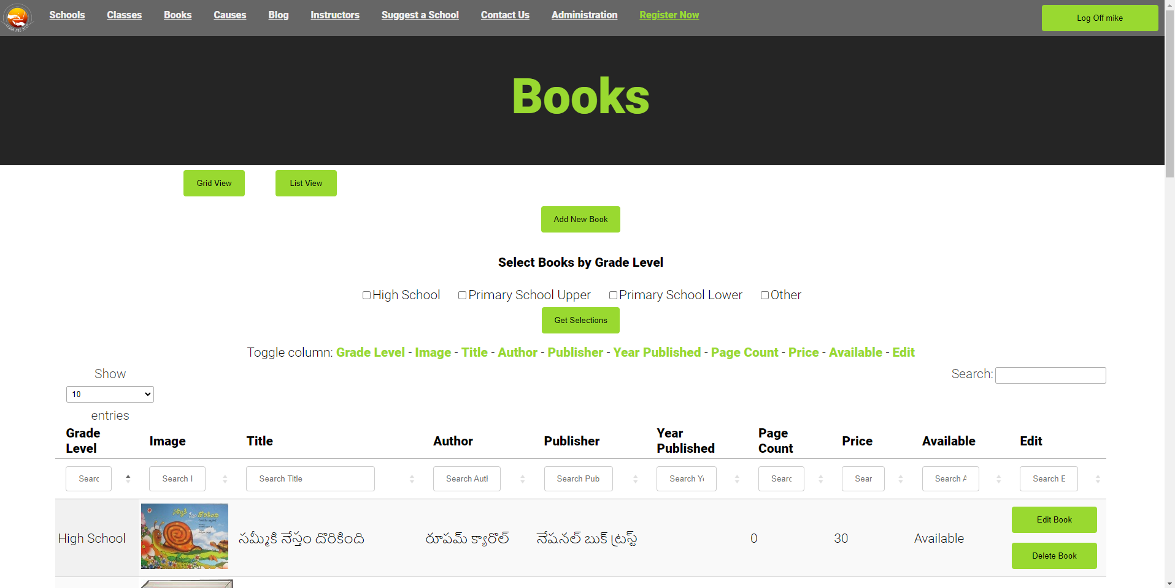
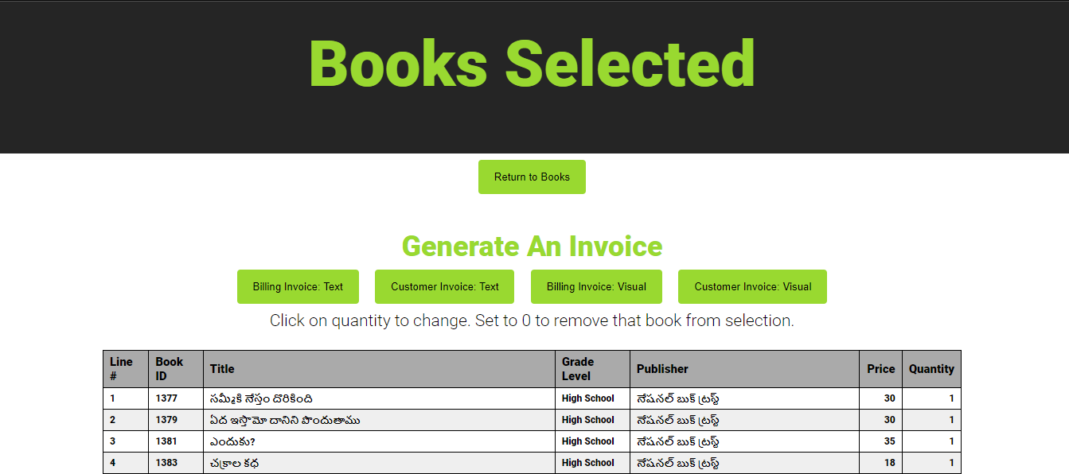
Books
As an Admin
Admin can view books by grade level
Admin can generate an invoice for customers
What we implemented/changed
Added ‘Grid View’ and ‘List View’ Buttons
Button function linked to appropriate view
Consolidated Web Pages - Content unchanged
Removed ‘Books (Grid)’ from Toolbar
Added Filter (Grid vs List view), modified filter/sort by Grade Level
Notes:
(Mekdes)

Slide 10
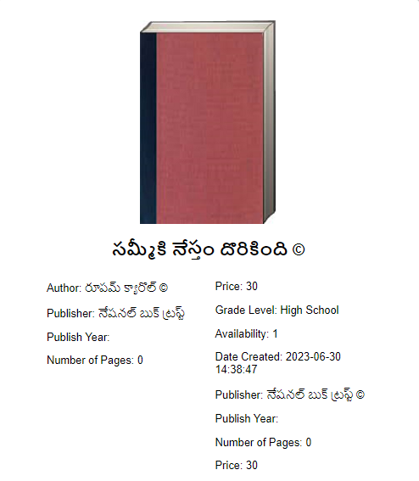
Book Report
As an Admin
Admin can view the book details
What we implemented/changed
Added unicode for language support, & accessibility
Added protection of copyright law
Notes:
(Mekdes)
Support global audience (Internationalization and Localization) and added copyright protection.

Slide 11
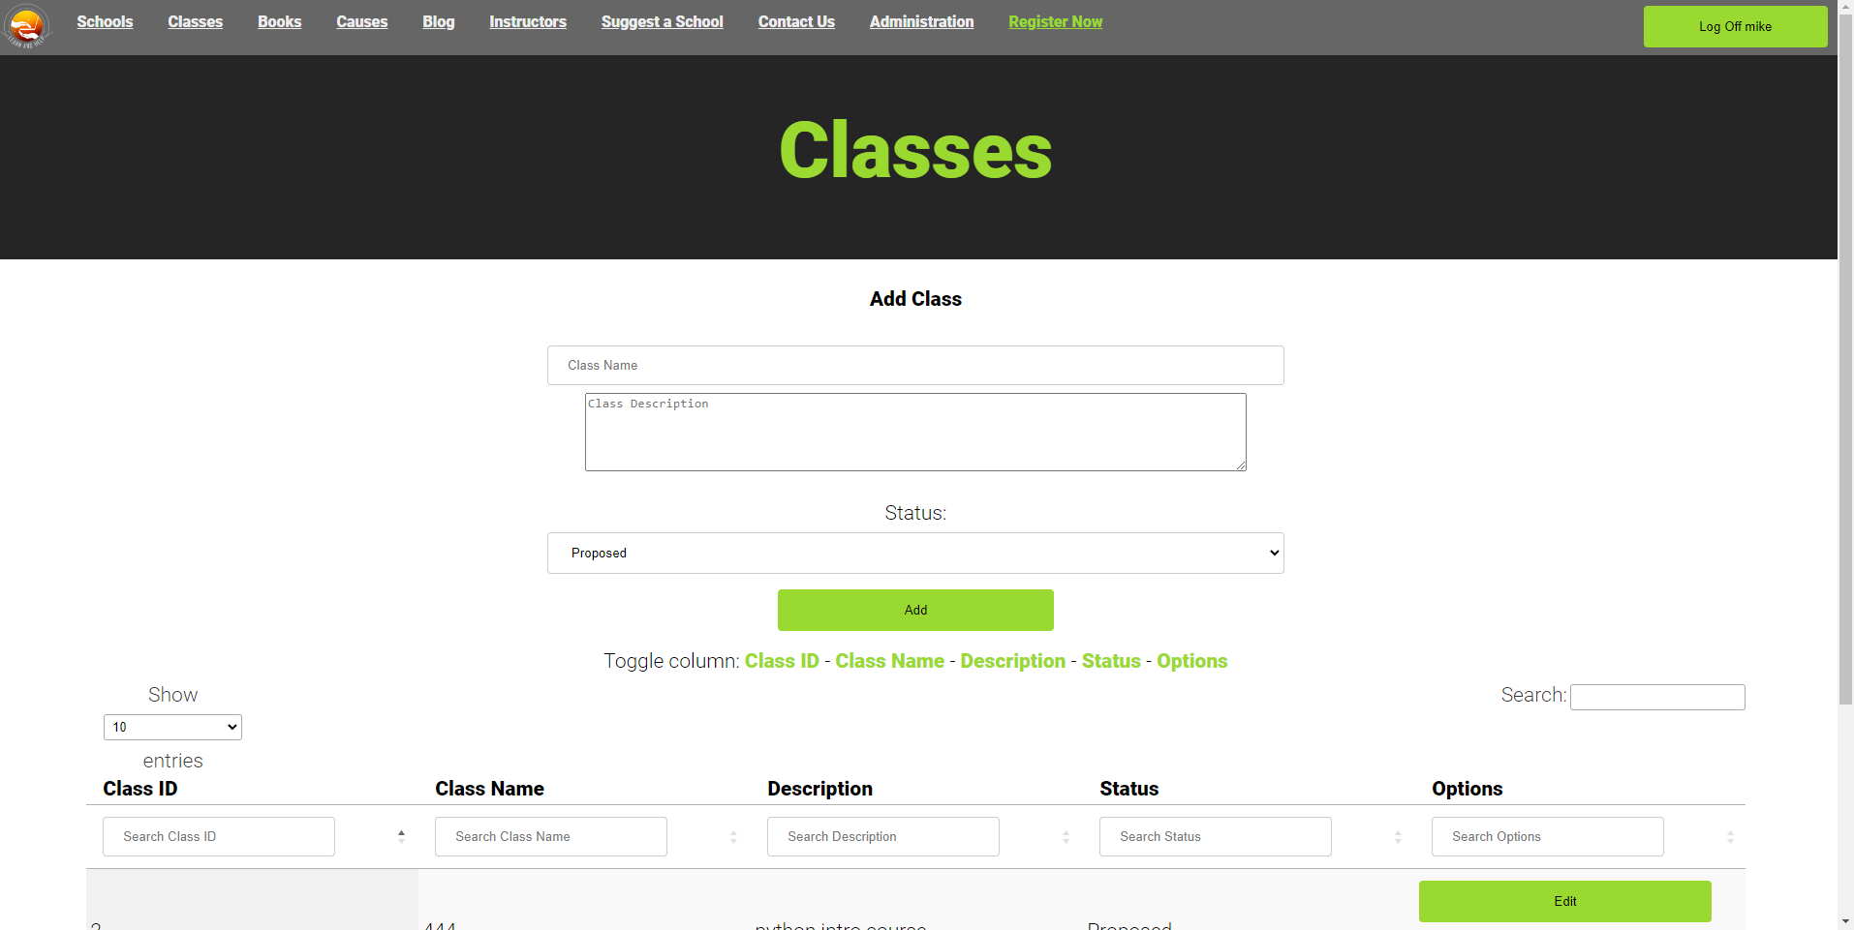
Classes
As an Admin
Allows Admin to perform CRUD operations on Classes.
What we implemented/changed
Added “Status” drop-down (Approved, Proposed, Inactive)
Added Delete protection (prompt/warning)
Form fields were made adjustable
Notes:
(Mekdes)

Slide 12
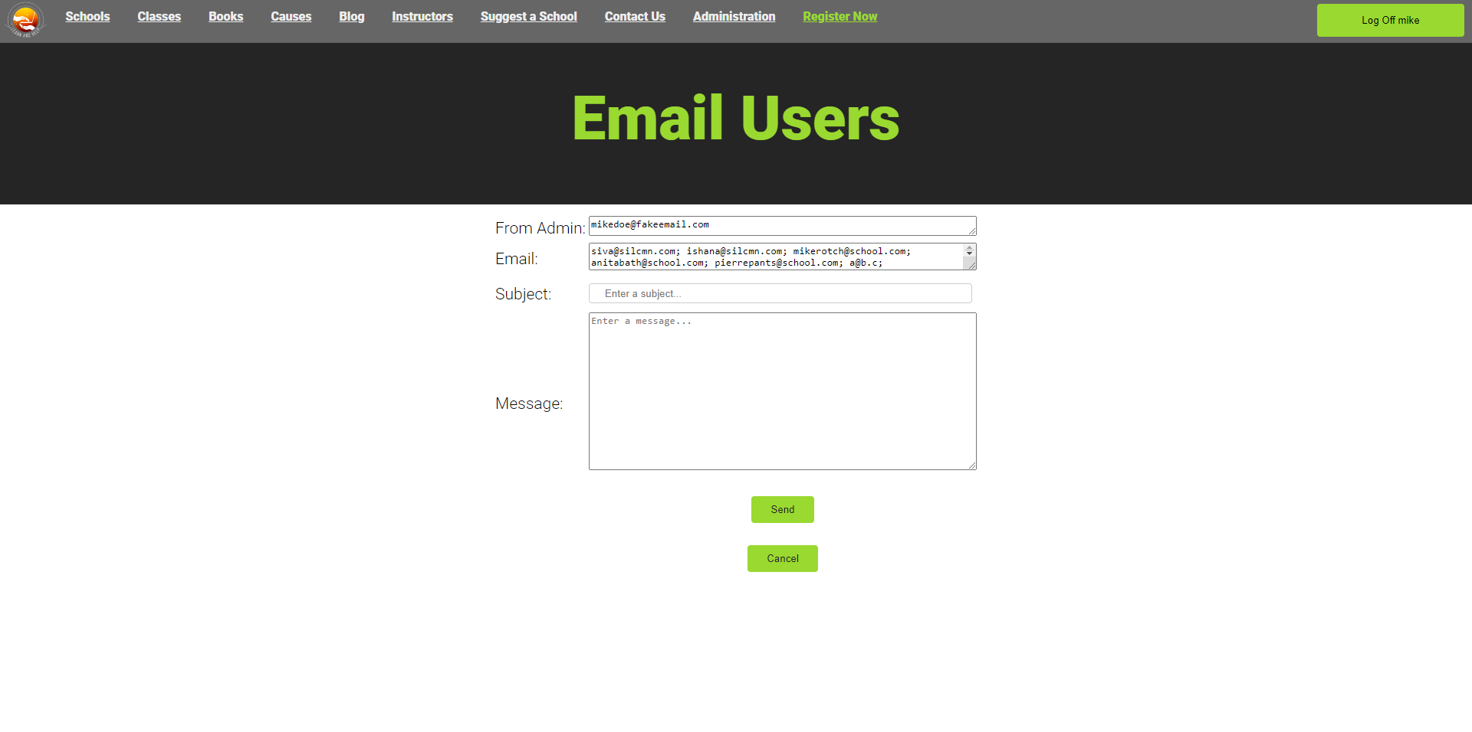
Email Distribution
As an Admin
Can send email to all registered users
All Admins get the same email
What we implemented/changed
Updated Form fields to adjustable
Added Send & Cancel buttons
All Emails pulled in from database.
Added email Icon (Administrator Page)
Notes:
(Jet) admins can send an email to all registered users for updates or news (server down, etc…), in the second Textbox called email contains all the registered users’ email from the database in which the logged in admin can control which email can receive the message.

Slide 13
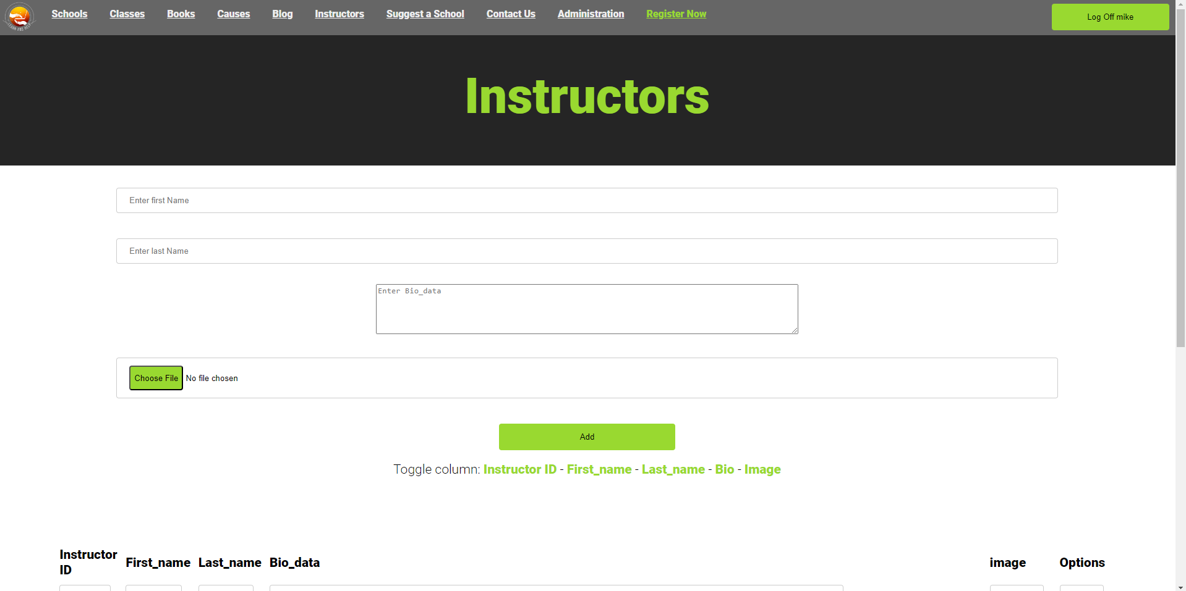
Instructors
As an Admin
Can perform CRUD operations (Was static info before)
What we implemented/changed
Added Instructors Icon to (Administrator Page)
Ability to upload a image as profile
Added Edit/Delete buttons Instructors.
Added columns as shown
Added provisions in database
Added Delete protection (prompt/warning)
Notes:
(Jet) Admins can create a new instructor or update or delete an existing instructor from the list or database
Admin can approve or remove the suggested school from visitors/users

Slide 14
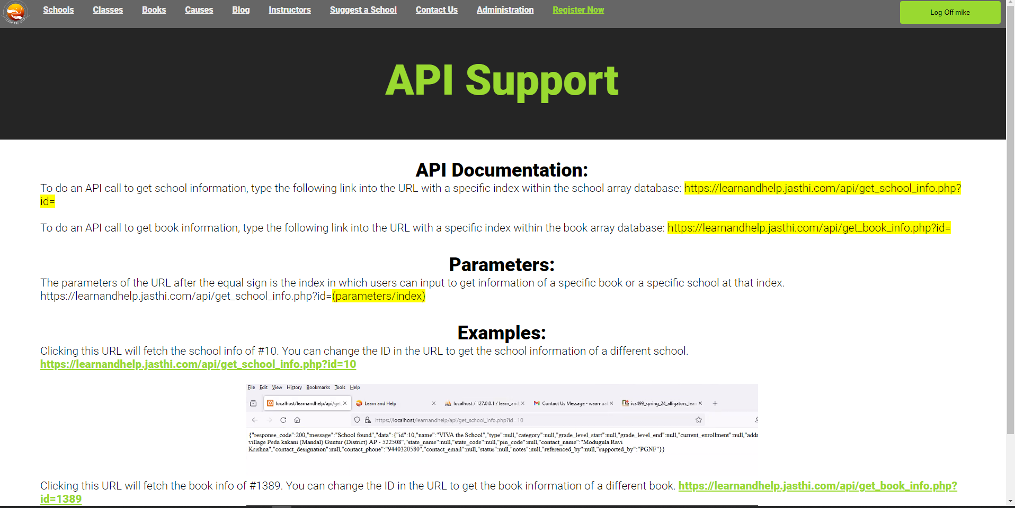
API
As an Admin
Admin can read how to use API to get information about school and books.
Admin can view data information by clicking on the links to the examples (JSON format)
What we implemented/changed
Added API Icon (Administrator Page)
Added associated webpage and images
Notes:
(Jet) an API support document to help guide users/ admin how to use API to get JSON data

Slide 15
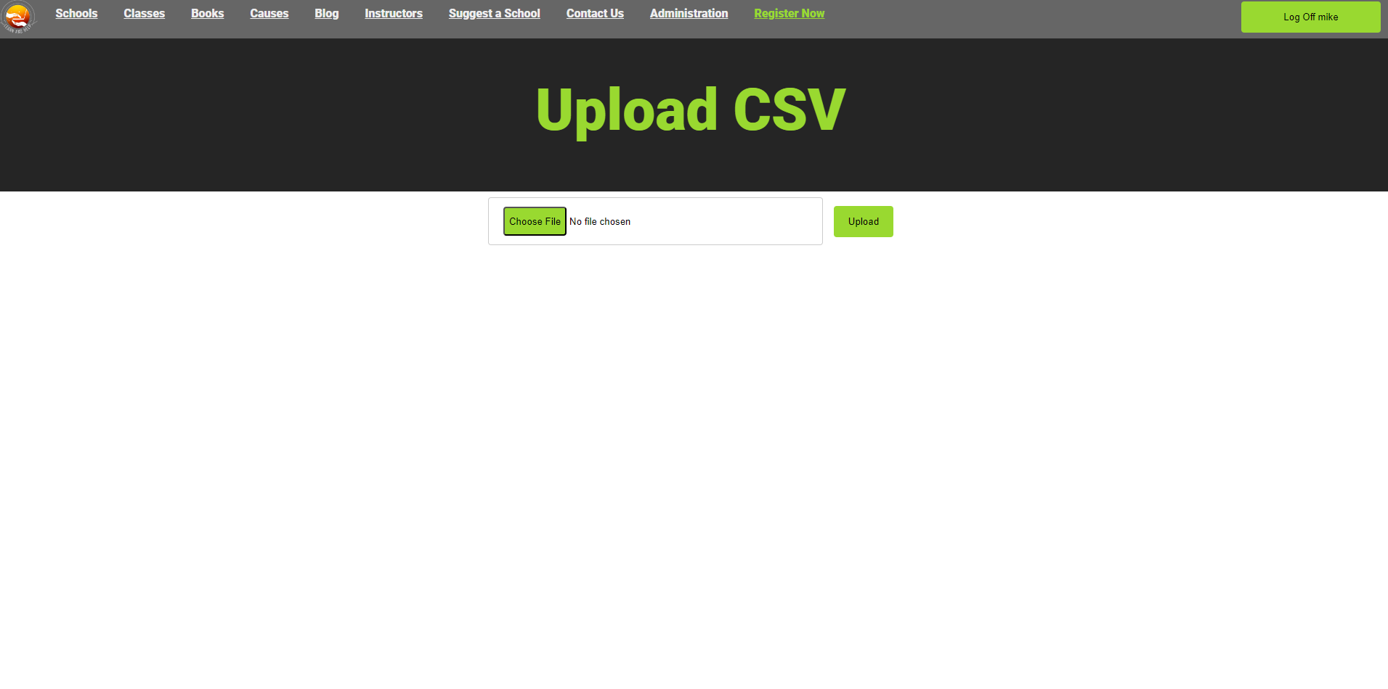
Upload CSV
As an Admin
Can update database with school information via a CSV file (e.g address, phone numbers, etc.)
What we implemented/changed
Upload Icon (Administrator Page)
Linked icon to existing webpage
Functionality remains unchanged
Notes:
(Jet) admin can update database with school information by uploading a CSV file with proper data, the professor sent a new data file with updated zip code

Slide 16
User / Visitor Functionality
Notes:
(Pong & Hamdi)
Fixed the format for all the user/visitor slides to better organize the split between what the user/visitors sees and what the team has implemented/changed.
Simplifying multiple bullets into a singular bullet point

Slide 17
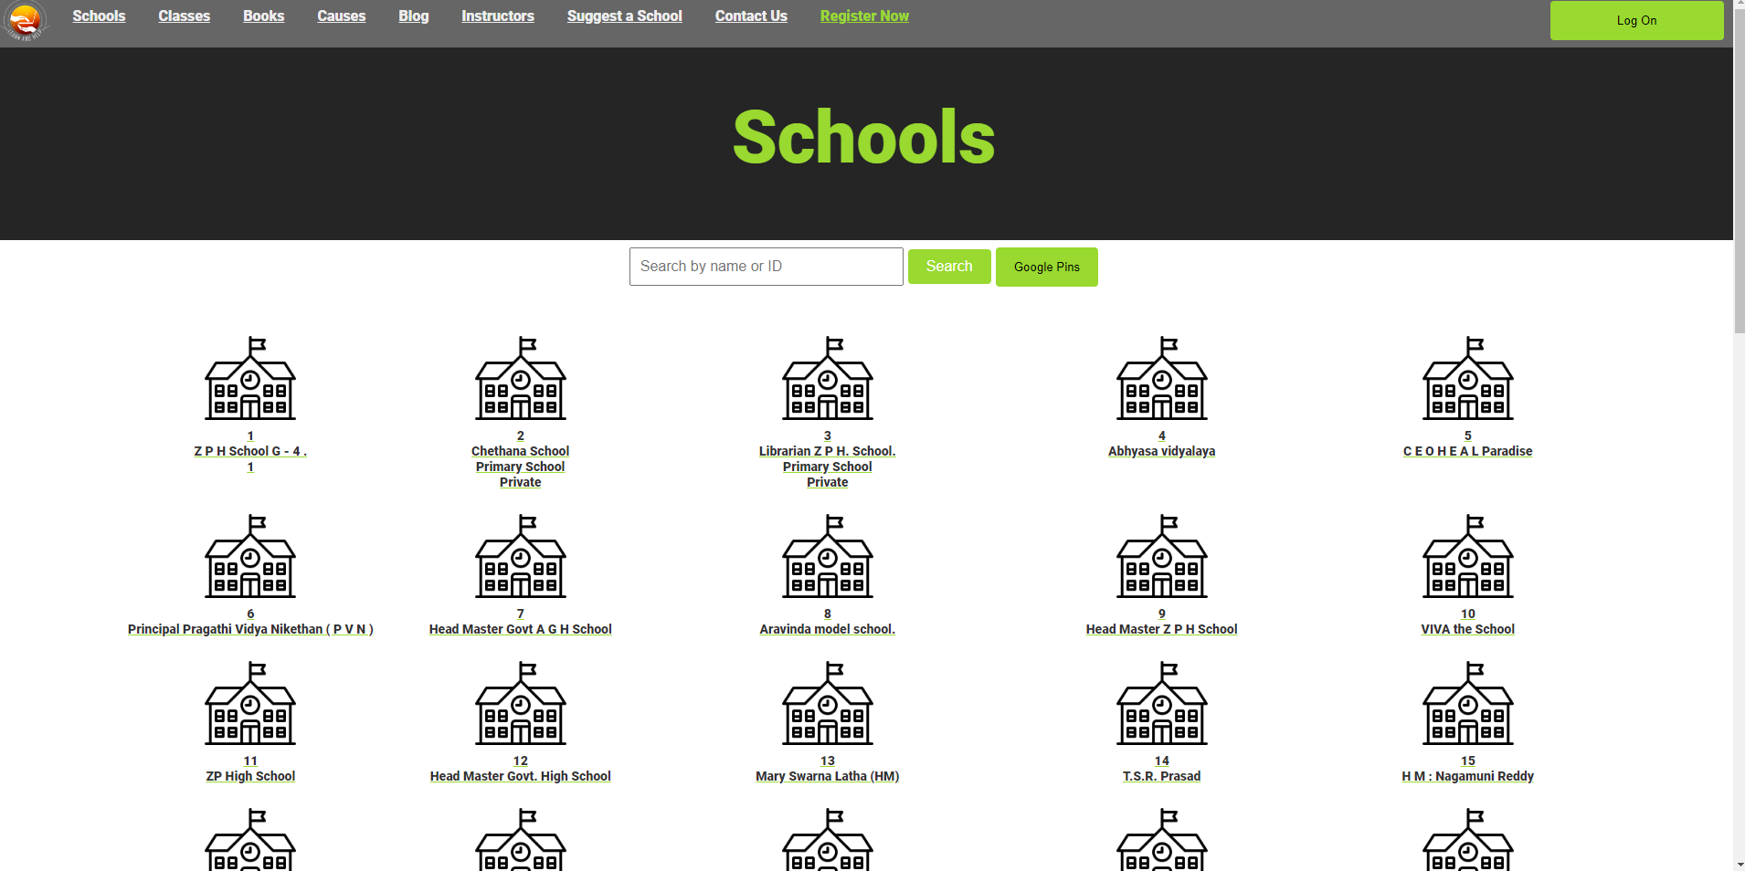
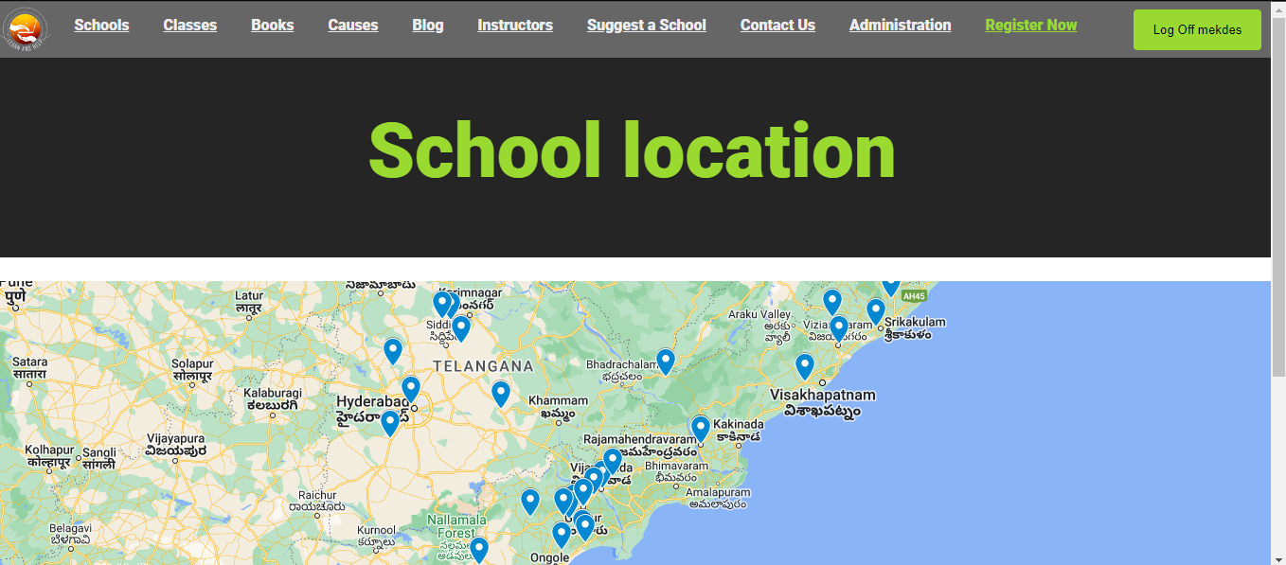
School
As a user/visitor
Here Users/Visitors can see a list of schools
When User/Visitor clicks on google pins it will take them to a google maps with all the school location on it.
What we implemented/changed
Implemented Google Pins Button to display a map with school locations fetched from a database, receiving easy access and visualization of relevant information.

Slide 18
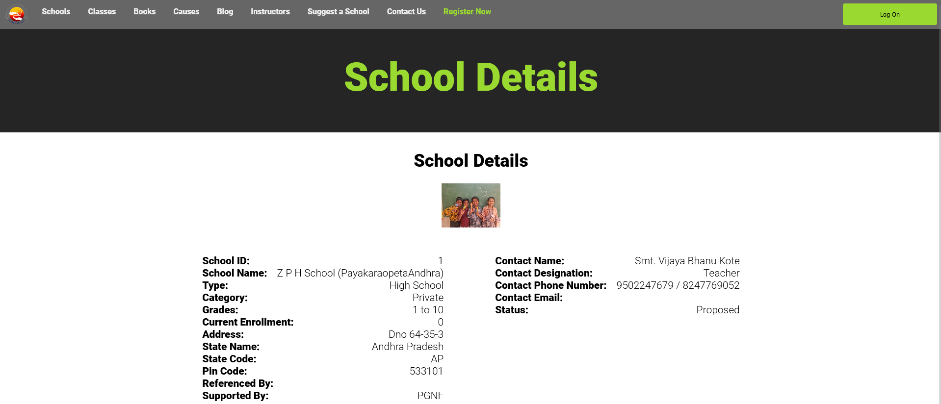
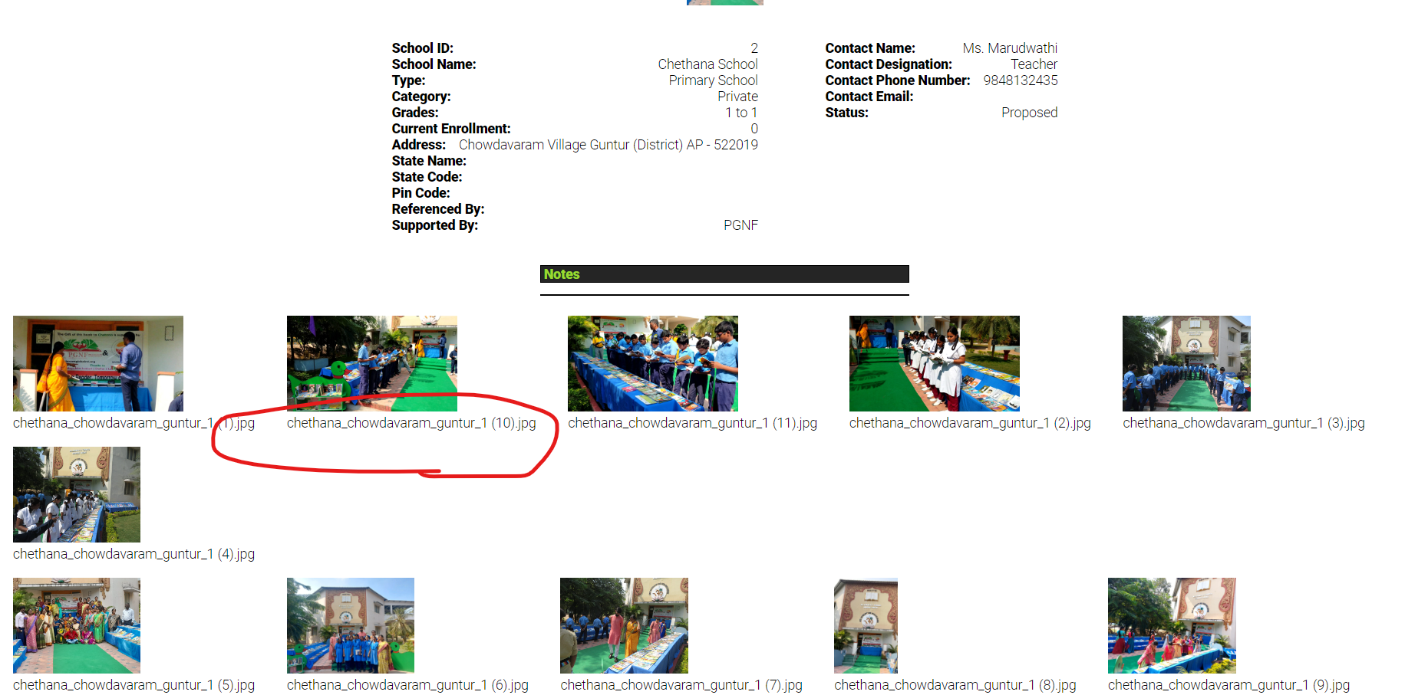
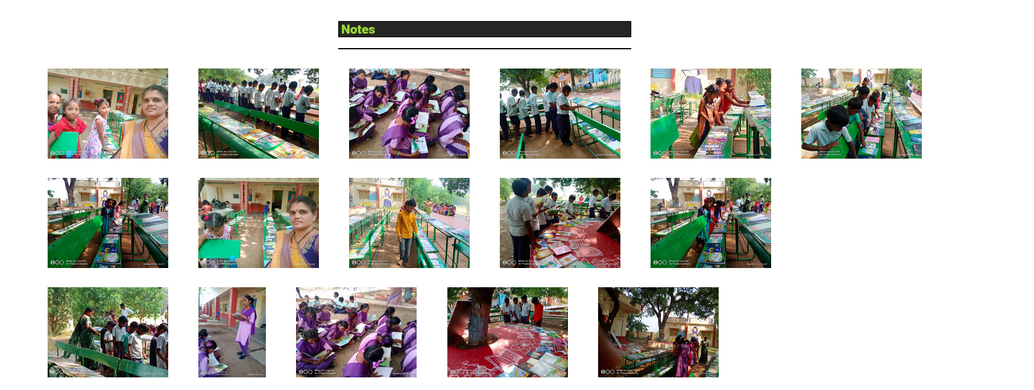
School details
As a user/visitor
When a user/visitor clicks on a school they’re interested in they will see a more detailed information about that school
What we implemented/changed
We removed the file names for the images
Before
After

Slide 19
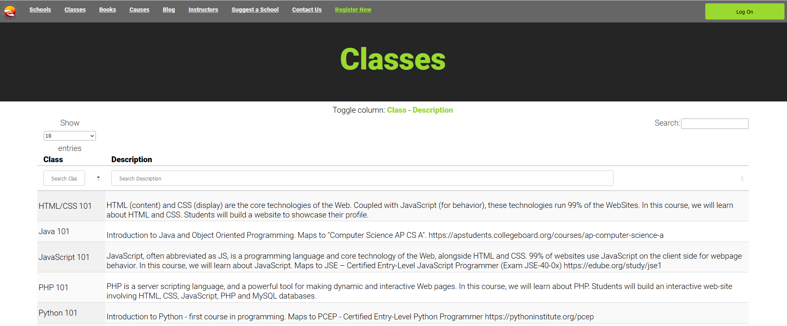
Classes
As a user/visitor
When a user/visitor clicks on classes they will see a list of classes and its description.
What we implemented/changed
Classes data pulled from Database as it was static before.

Slide 20
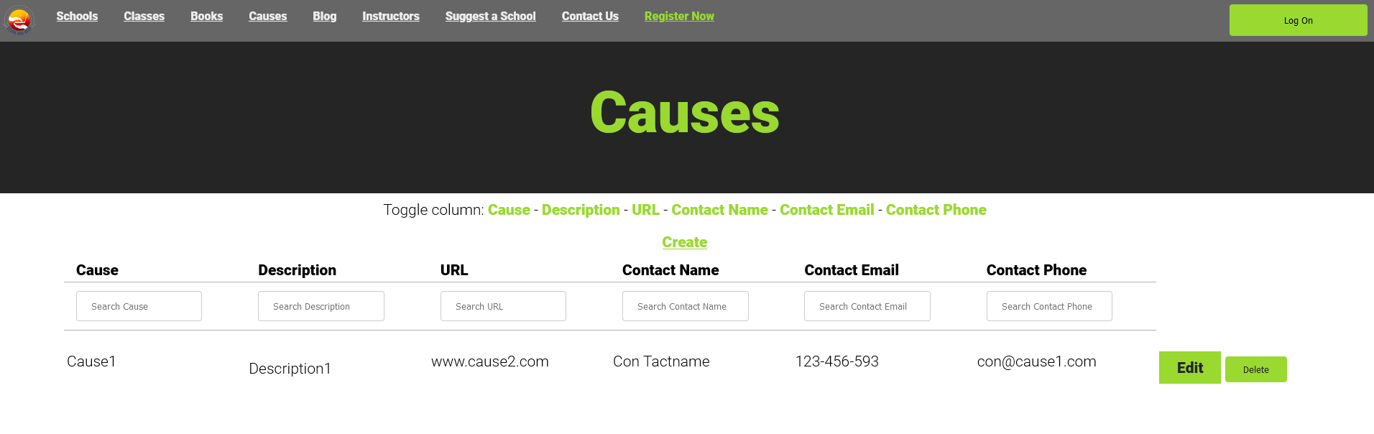
Causes
As a user/visitor
Here a user/visitor can create a new cause to help give more options of volunteering.
What we implemented/changed
No implementation was added/changed on “causes”

Slide 21
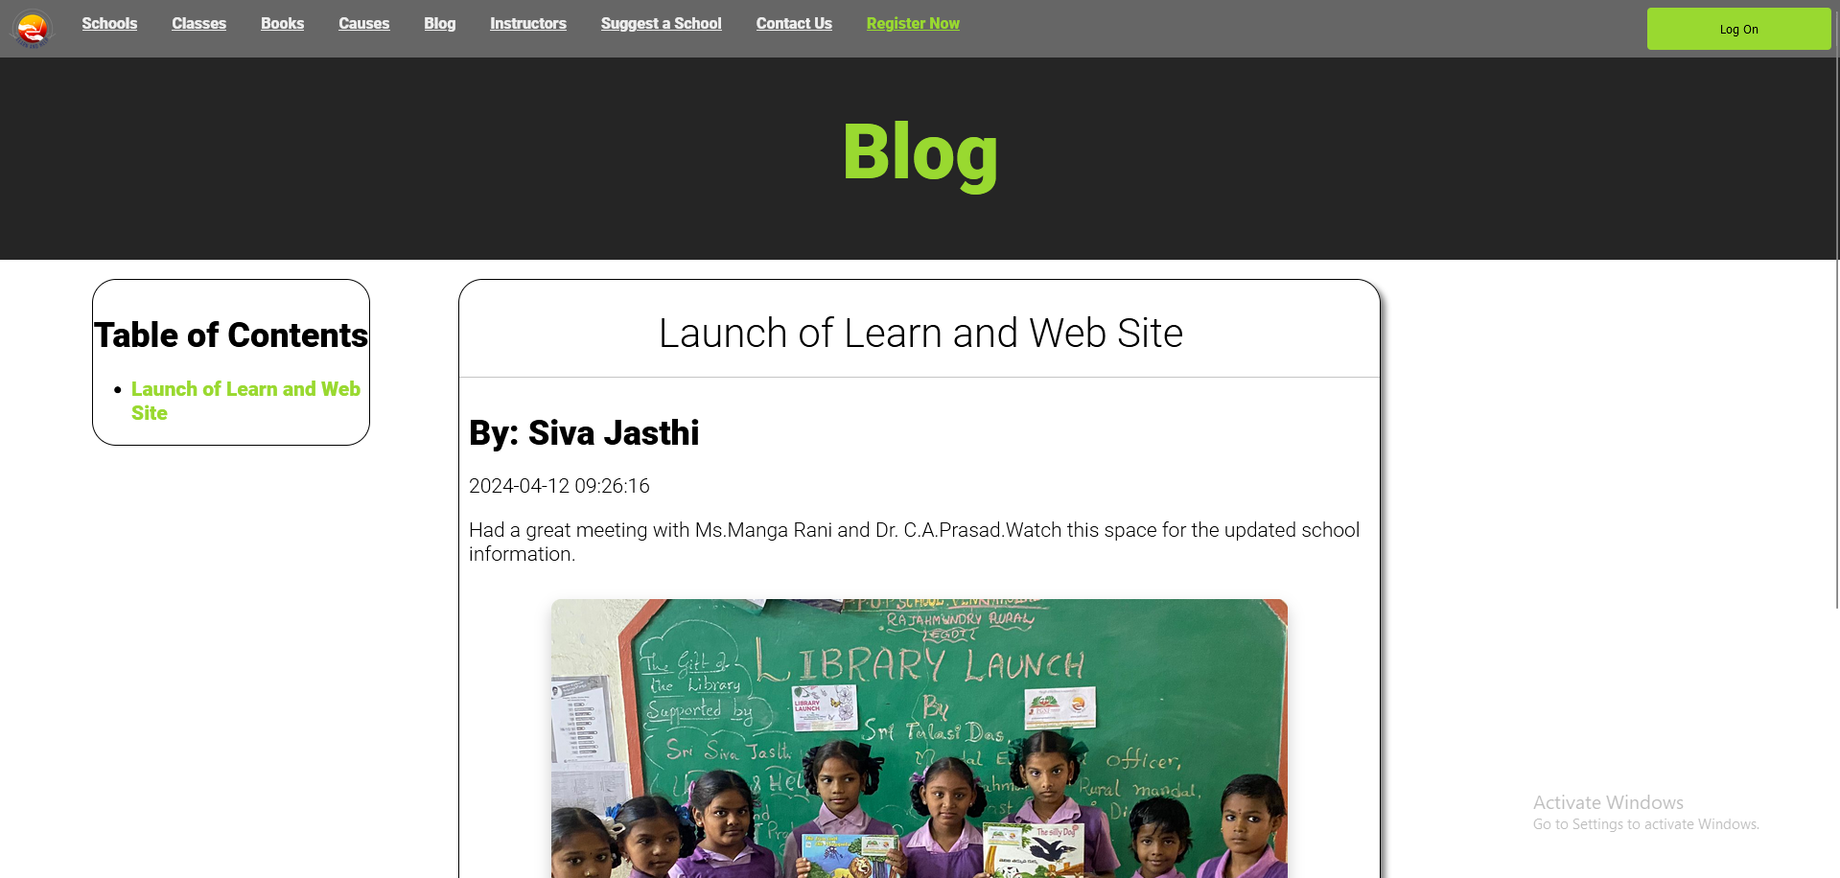
Blogs
As a user/visitor
In blogs users/visitors can see blogs written by admins or teacher talking about what is new and happening.
What we implemented/changed
Our team didn't change anything

Slide 22
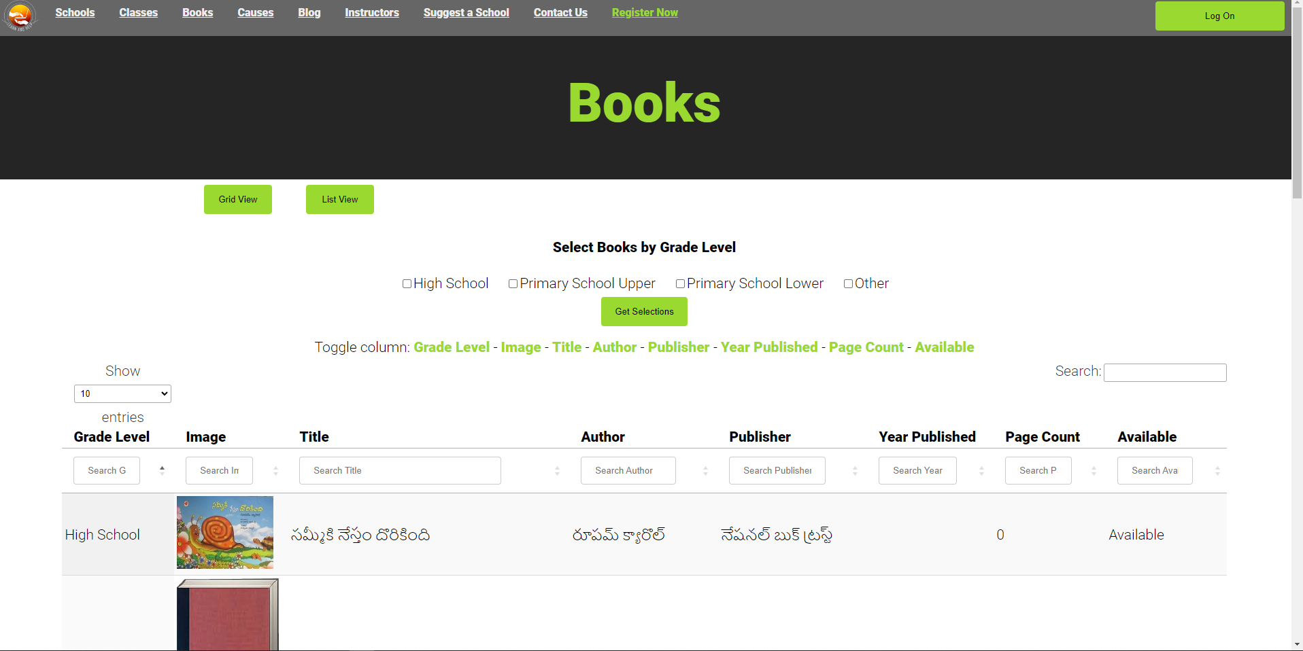
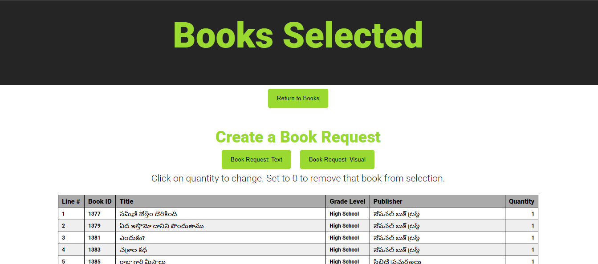
Books
As a user/visitor
Users/visitors can browse, view details, request, and filter books by grid, list, details, and grade levels.
What we implemented/changed
We implemented two buttons that changes the view from either a grind view or a list view
Notes:
Reference again this is from a User’s perspective. Functionality added was explained earlier in Admin slides

Slide 23
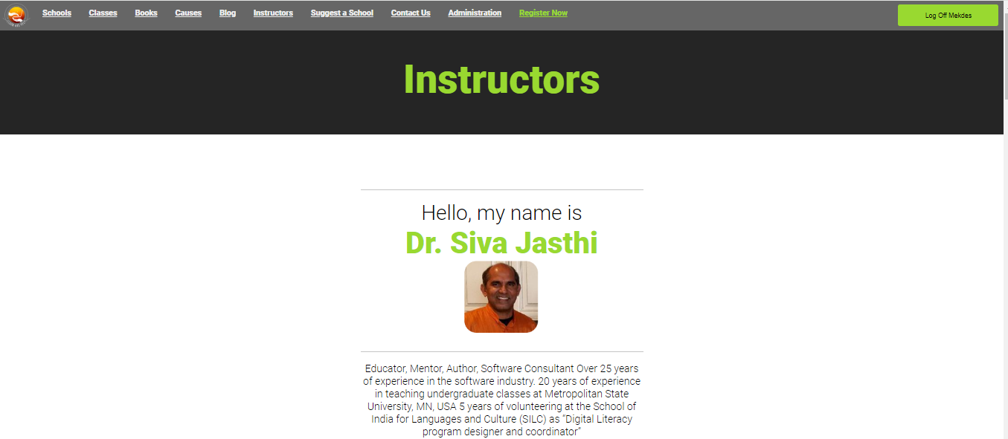
Instructors / Meet Instructors
As a user/visitor
User/visitors can view a list of instructors that are teaching courses on the Learn and help website
What we implemented/changed
Instructor data pulled from Database as it was static
Changed toolbar name from “Meet our Instructors” to “Instructors”.
Users can view all instructors and read their biography.

Slide 24
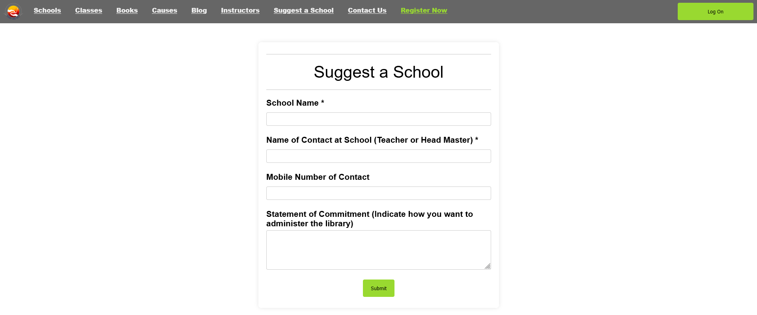
Suggest a School
As a user/visitor
A user/visitor can suggest their own school or a school they know that can provide more hands on experience.
The suggested school then sent to the admin
What we implemented/changed
We implemented a form that the user/visitor uses to send the suggested school.

Slide 25
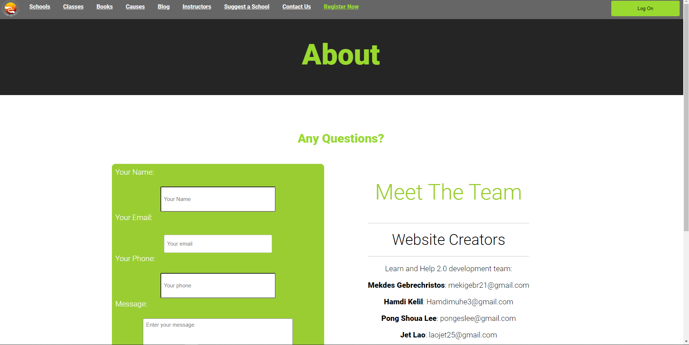
Contact Us
As a user/visitor
Users/visitors can send an email about any questions to an admin about anything related to the website or to receive more information on certain topics
What we implemented/changed
Updated Form
Every admin gets the Contact Us form data via email
Fixed link to Learn & Help PDF
User can send an email to admins about questions they have

Slide 26
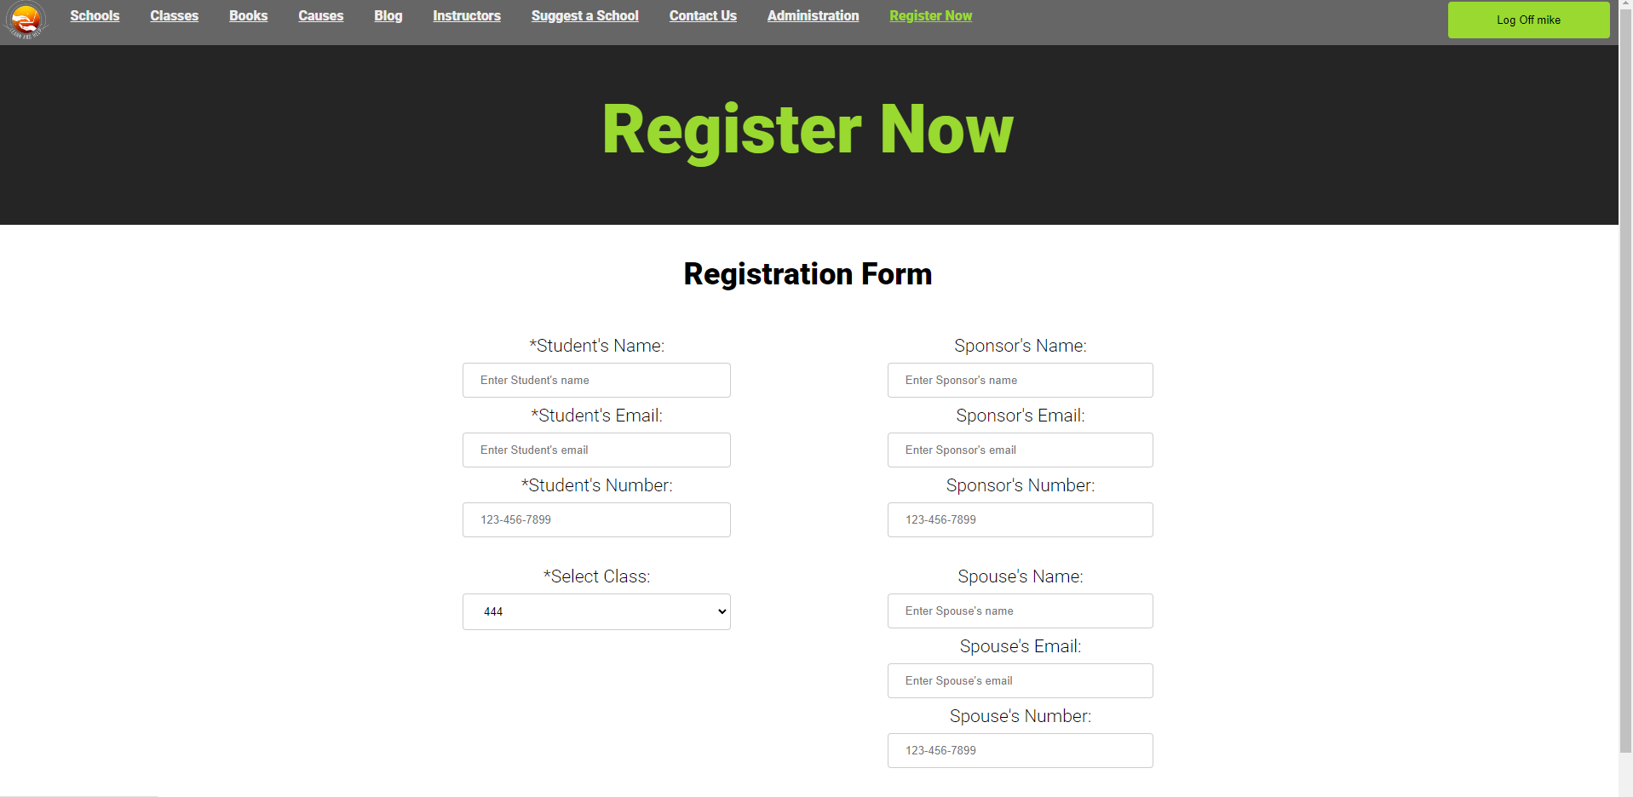
Register Now
As a user/visitor
As a user they can register for a class
If a visitor is to click on the “Register now” button it will take them to the login page to either login or create a account.
What we implemented/changed
Requires registered user to View
Updated Form data.
Form pulls in “Approved Classes” for user to select (was static content)

Slide 27
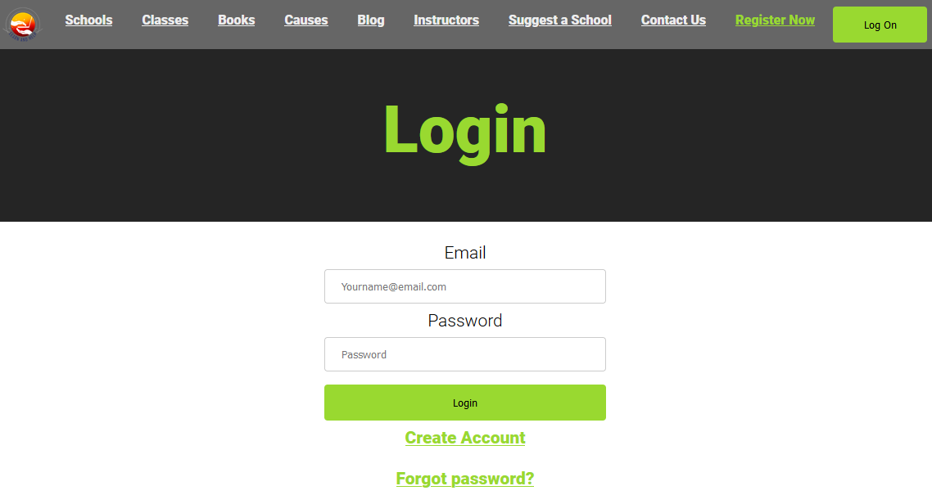
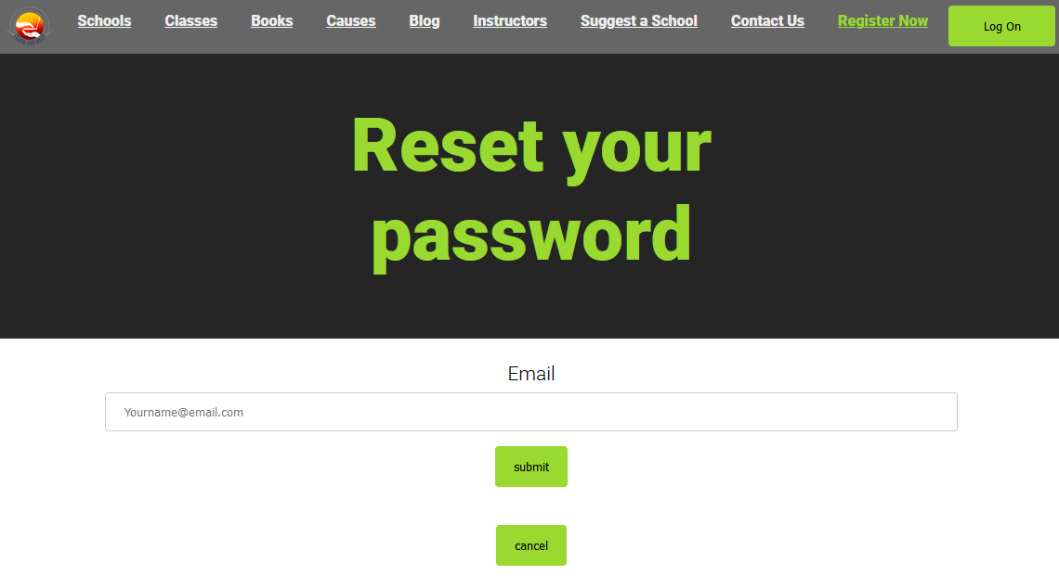
Reset Password
As a user/visitor
If a user forgets their password they can request one by clicking on the forgot password which will then prompt them to follow a couple of steps to reset their password
What we implemented/changed
Implemented forms with password reset functionality, enchanting new format: eight characters including six numbers, one lowercase letter, and one symbol, with hashed token validation and existing email database check.

Slide 28
Q & A
Thank you !
Mekdes Gebrechristos
Hamdi Kelil
Pong Shoua Lee
Jet Lao
Daniel Kolles
Dr. Siva Jasthi

